Slide 1
NNs & Deep Learning

Slide 2
Contents
Neural Network Basics
  Perceptron
  Activation Function
Neural Network
  Basic Structure
  Vector Notation
The Softmax function
Backpropagation Algorithm
Deep Learning

Slide 3
Neural Network Basics

Slide 4
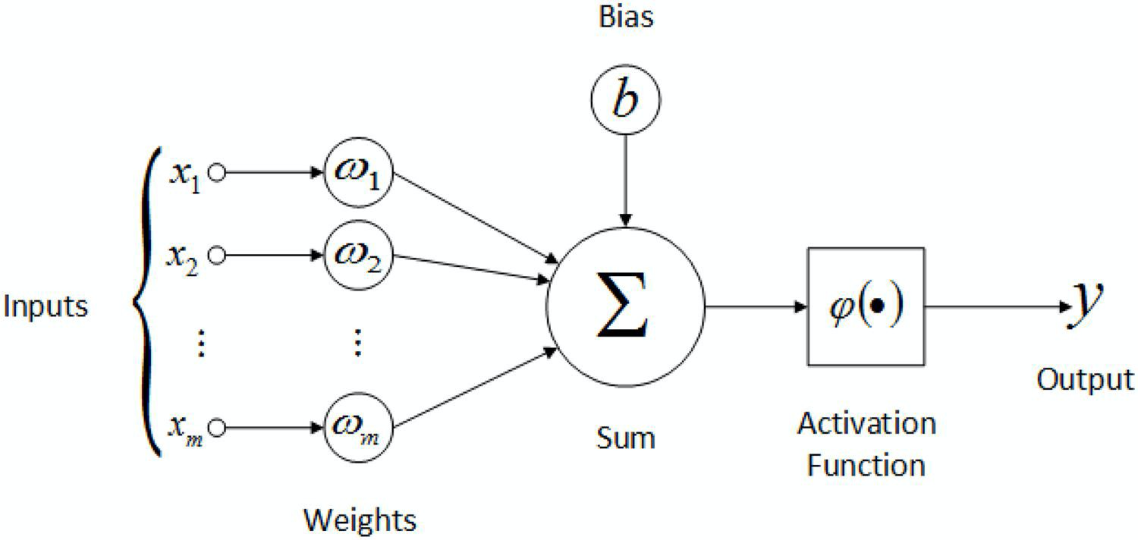
Perceptron
Perceptron Components :
  Input : x₁… x_{m}
  Weights : ω₁ … ω_{m}
  Bias : b
  Activation Function : φ
Operation :
  y = φ (x₁w₁+x₂w₂+...+x_{m}w_{m}+b)
Image credit : https://medium.com/@jayeshbahire/the-artificial-neural-networks-handbook-part-4-d2087d1f583e

Slide 5
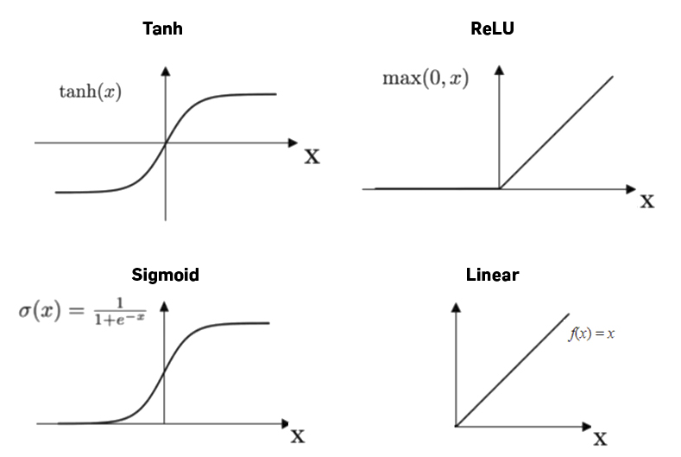
Activation Function
Otherwise called a transfer function
Applies a transformation defined by that function to sum of inputs and weights (and bias)
Examples of activation functions:
  Linear
  ReLU
  Sigmoid
  TanH
Image credit : https://docs.paperspace.com/machine-learning/wiki/activation-function

Slide 6
Neural Network

Slide 7
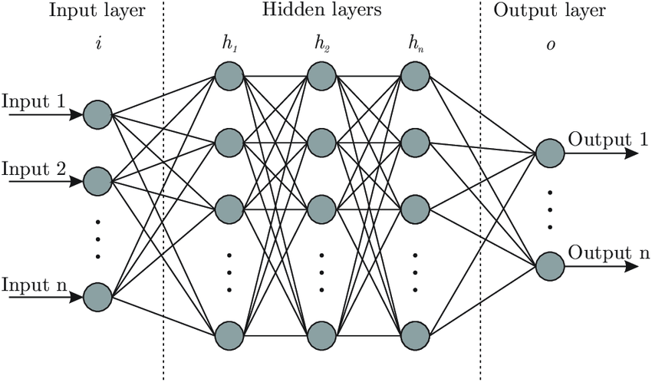
Neural Network or Multilayer Perceptron
Input layer :
  Passes raw inputs to first hidden units (h₁)
Output layer :
  Applies transformation to the outputs.
Hidden layers :
  Densely connected perceptrons
Image credit : https://medium.com/@jayeshbahire/the-artificial-neural-networks-handbook-part-4-d2087d1f583e

Slide 8
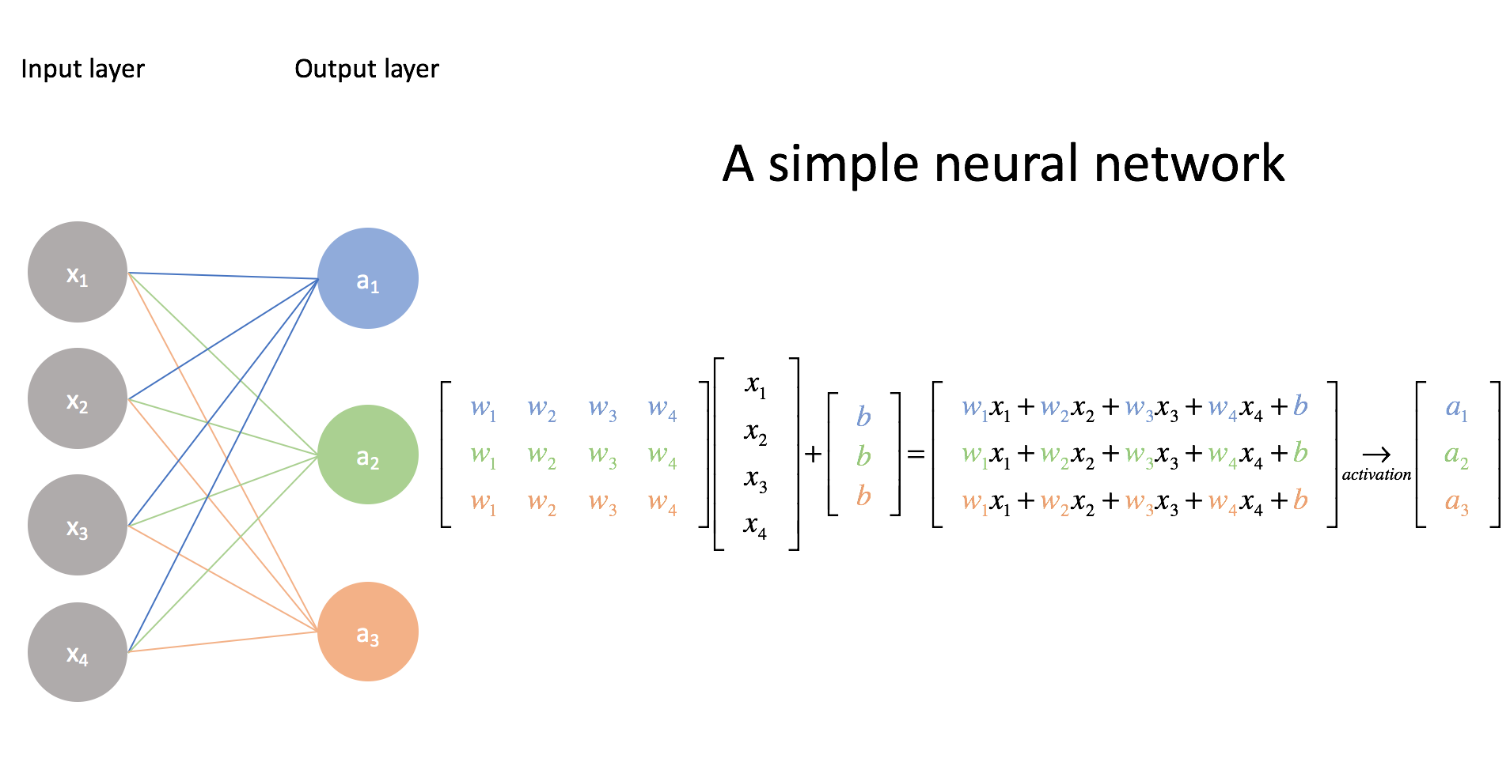
Vector Notation
Can represent weights of a layer as a matrix W
Can represent the input, bias and output as a vectors x, b, y
Activation function φ applies on each linear combination
Operation of this simple network is : y = φ(W^{T}x )
Image credit : https://www.jeremyjordan.me/intro-to-neural-networks/
Notes:
Multiple outputs mean multiclass classification. x as a vector means one observation

Slide 9
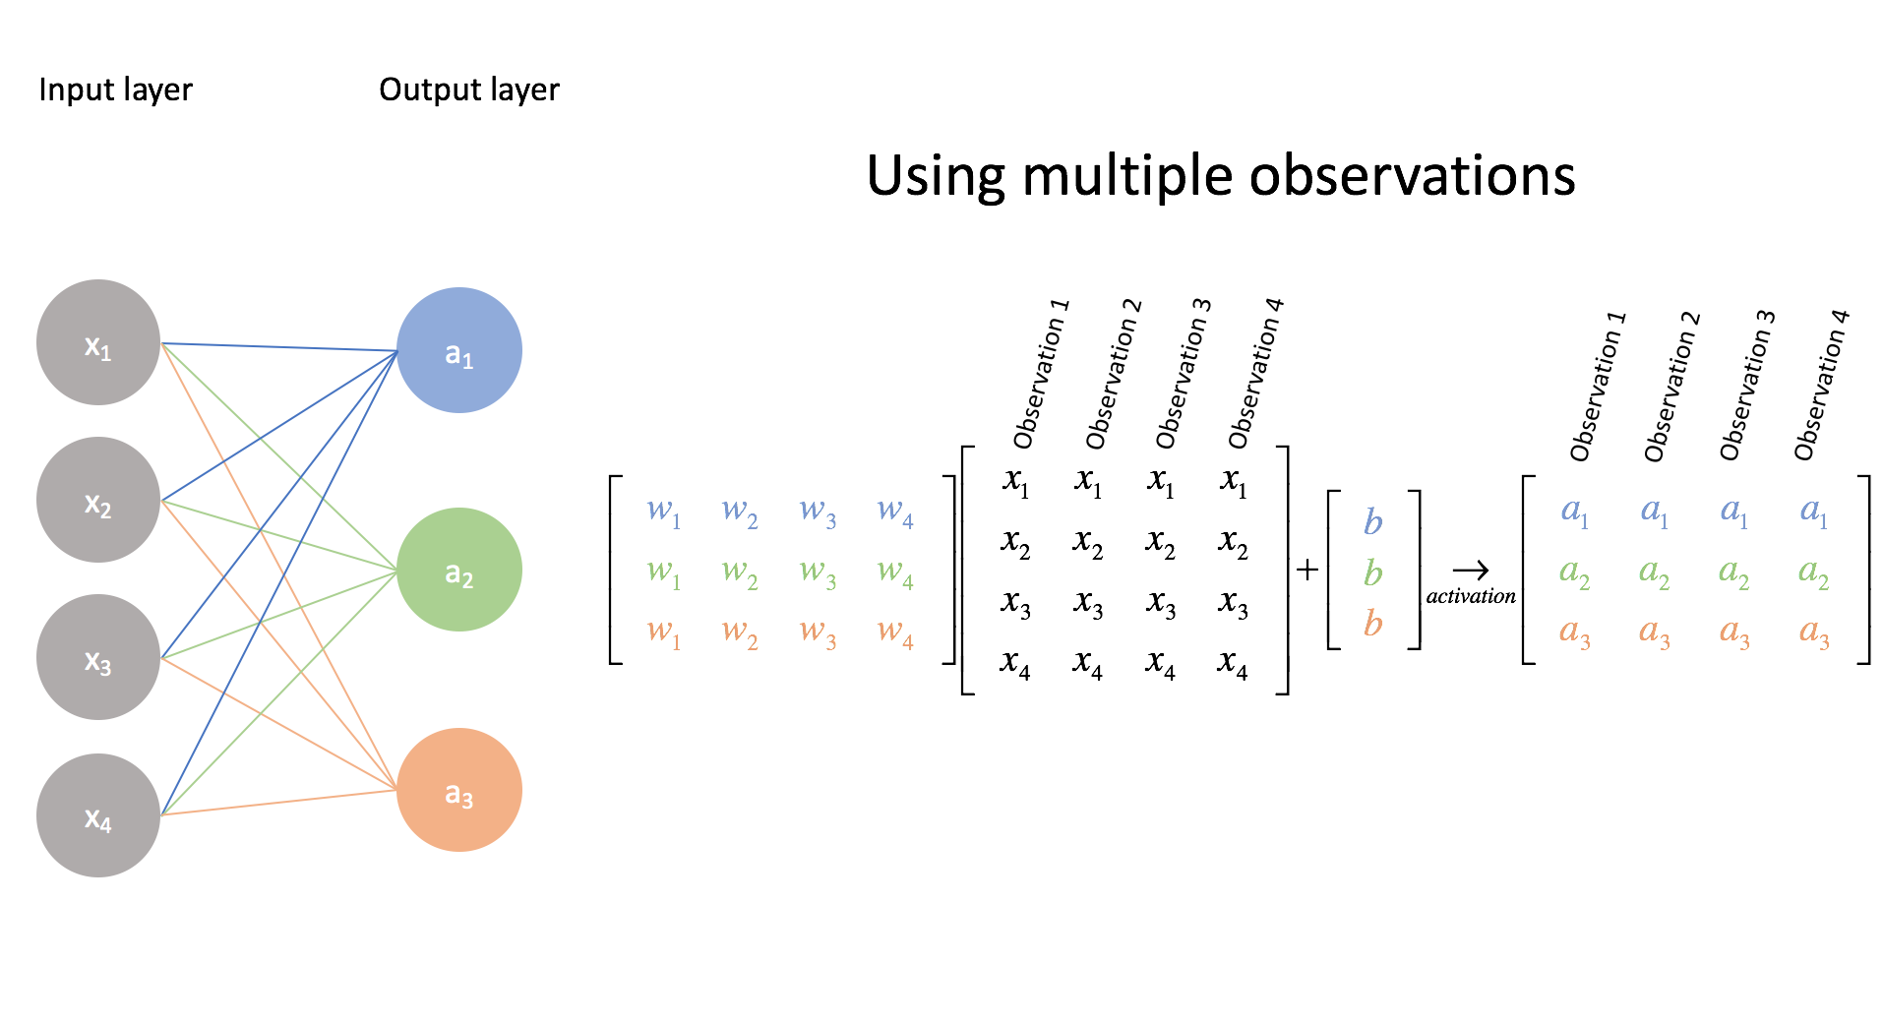
Vector Notation
We can add inputs in a batch to compute multiple inputs at the same time
Input vector x becomes matrix X
Output vector y becomes matrix Y
Image credit : https://www.jeremyjordan.me/intro-to-neural-networks/
Notes:
X matrix contains many observations

Slide 10
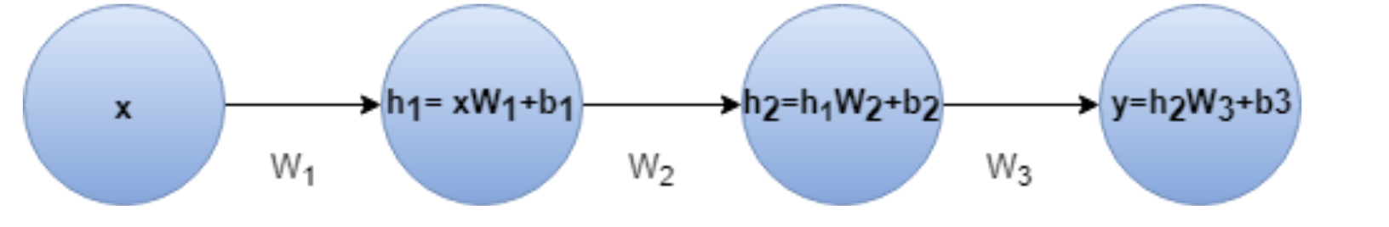
Importance of Non-Linear Activation
Non-Linear Activation helps network learn complex mappings
  eg. sigmoid, ReLU
If activations in all layers are linear network decays to a single linear layer
y = h₂W₃+ b₃
= h₁W₂W₃+b₂W₃ + b₃
= xW₁W₂W₃+b₁W₂W₃+b₂W₃ + b₃
= xW’ + b’

Slide 11
Learning for a neuron includes 3 components
A neural network (defined by its architecture, in other words the computational steps to evaluate the network output)
A loss function (a function to measure how good or bad the network is predicting the outputs)
An algorithm to minimize the loss function (also called optimizer: Gradient Descent, Adam..)
Source:Umberto Michelucci, Applied Deep Learning - A Case-Based Approach to Understanding Deep Neural Networks, APRESS 2018

Slide 12
Quiz: What can a neuron do?
We have discussed how a neuron looks like. But how can a neuron solve any type of problem?
Can a neuron solve a classification and a regression problem? How can we do that?
Question: which component of a neuron is responsible for the type of problem we want to solve?
Notes:
Draw on the blackboard all the components of a neuron and the 3 components of a model and ask students which part is relevant

Slide 13
Which portion of a neural network model is responsible for the type of problem that can be solved?
Two main components are responsible for the type of problem that can be solved:
The output activation function
The loss function
The optimiser is not related in any way to the type of problem solved.

Slide 14
Classification Problem
and output activation function
The Softmax function

Slide 15
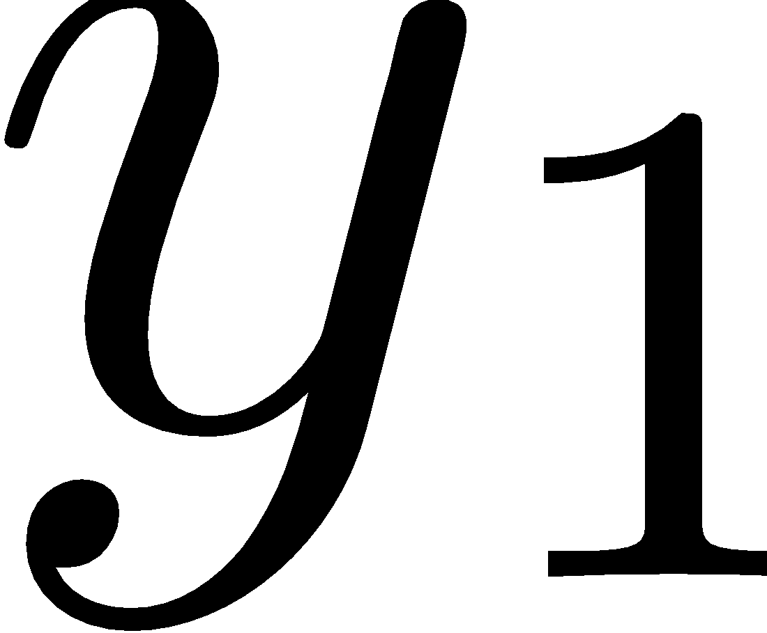

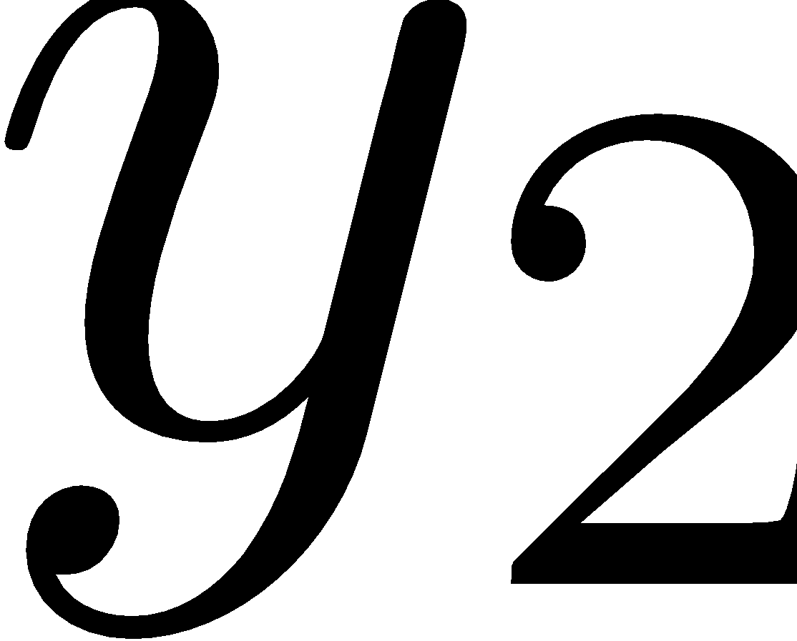
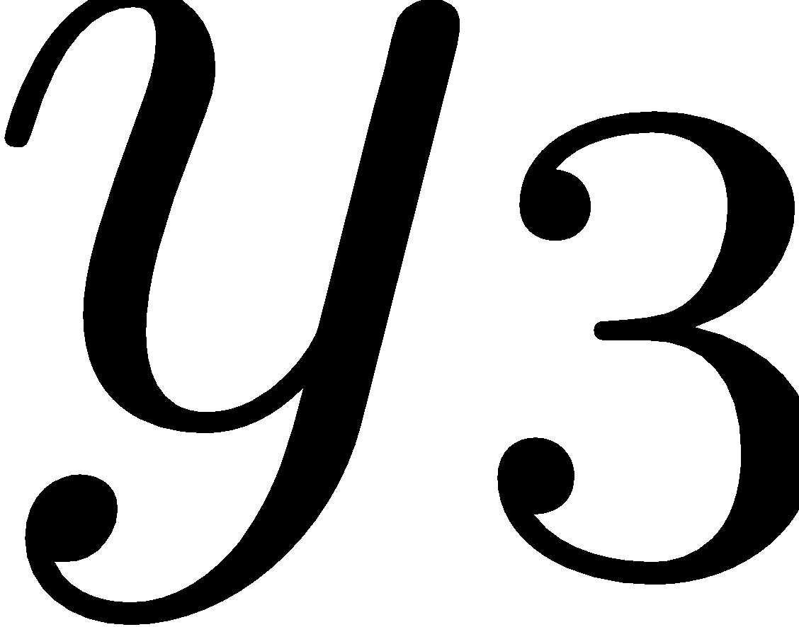
Neural Network Architecture (example with 3 classes)
How should we interpret those numbers?
We would like to interpret them as the probability of the input observation to be in class 1, 2 or 3.
Network
Input

Slide 16
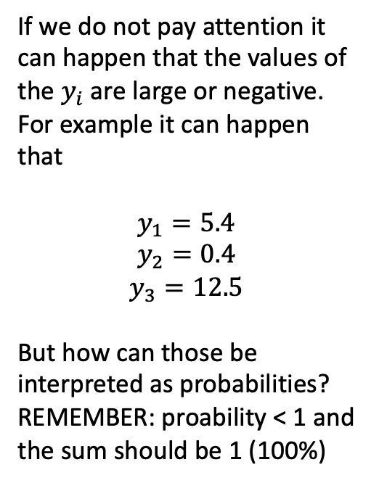
Neural Network Architecture (example with 3 classes)
Network
Input

Slide 17
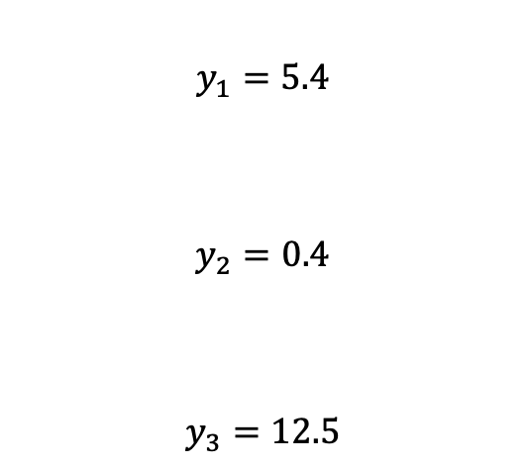
Neural Network Architecture (example with 3 classes)
Network
Input

Slide 18


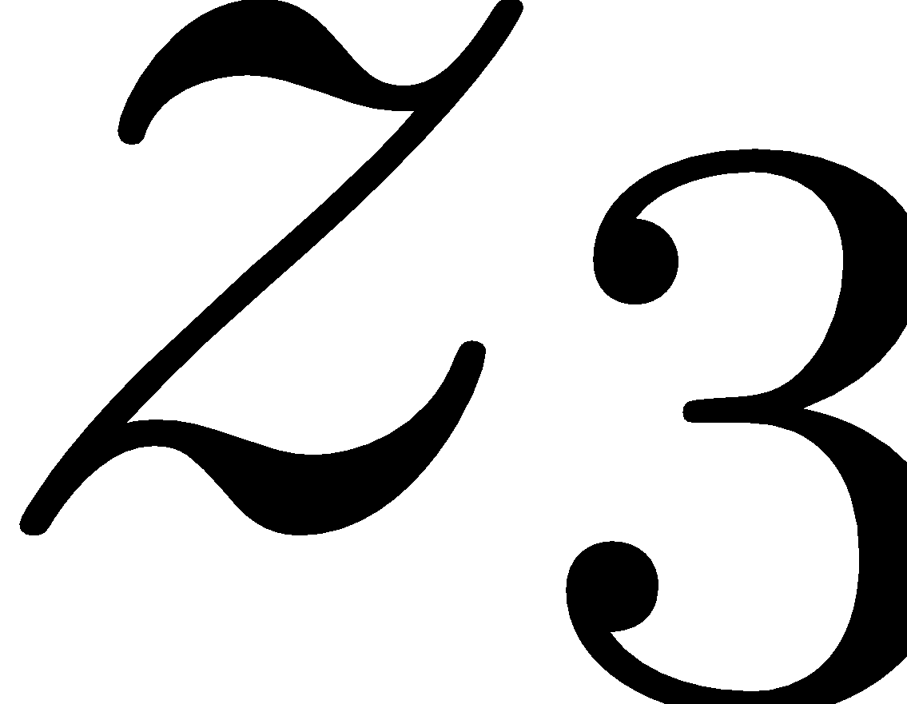
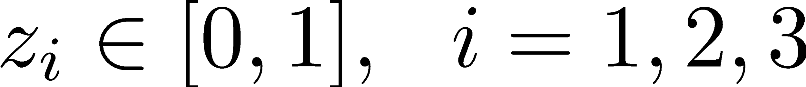
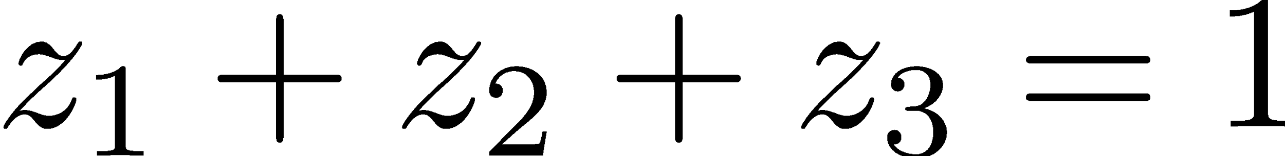
Neural Network Architecture (example with 3 classes)
Network
Function
Input

Slide 19
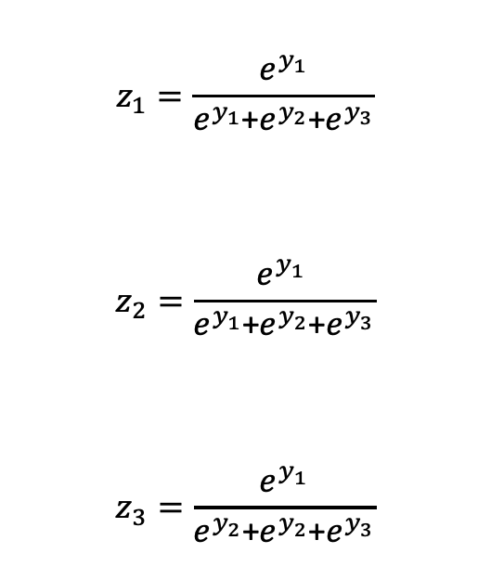
Neural Network Architecture (example with 3 classes)
Function

Slide 20
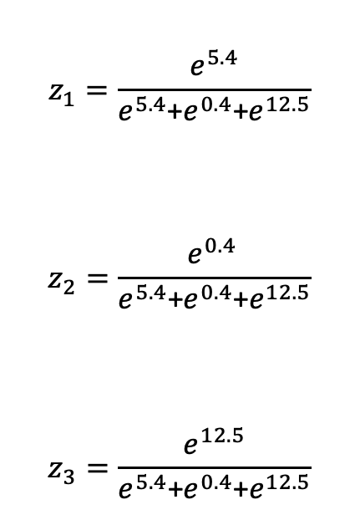
Neural Network Architecture (example with 3 classes)
Function

Slide 21
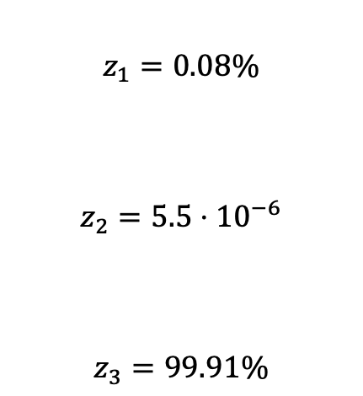
Neural Network Architecture (example with 3 classes)
Function

Slide 22
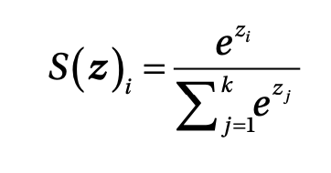
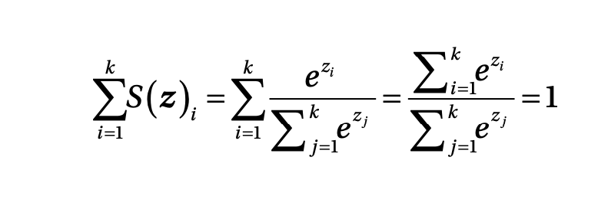
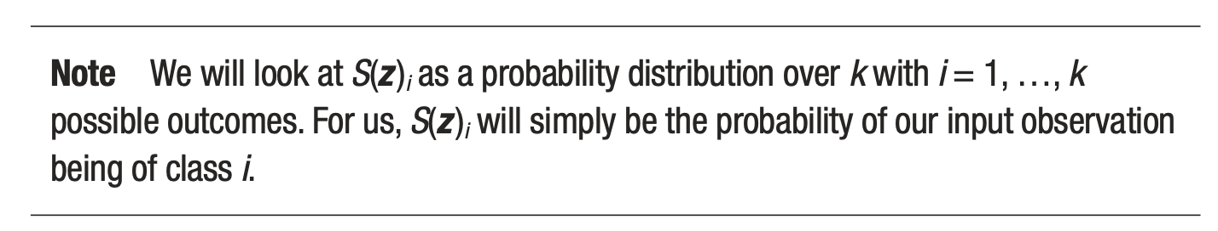
Softmax output layer for classification
Output of ith neuron of the output layer
Note that they can be interpreted as probability since the sum is equal to 1
Source:Umberto Michelucci, Applied Deep Learning - A Case-Based Approach to Understanding Deep Neural Networks, APRESS 2018

Slide 23
Backpropagation Algorithm

Slide 24
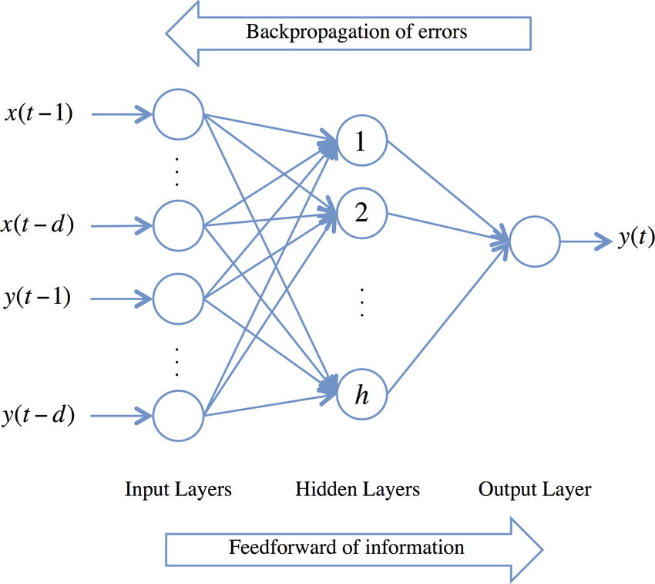


Backpropagation
Used to compute local gradients efficiently using the chain rule
  Need to compute
for every w in the network
Steps:
Forward pass : calculate y’ from x1 … xn
2. Backward step to compute derivatives :
Use chain rule
3. Weight update using :
https://blog.paperspace.com/intro-to-optimization-in-deep-learning-gradient-descent/

Slide 25
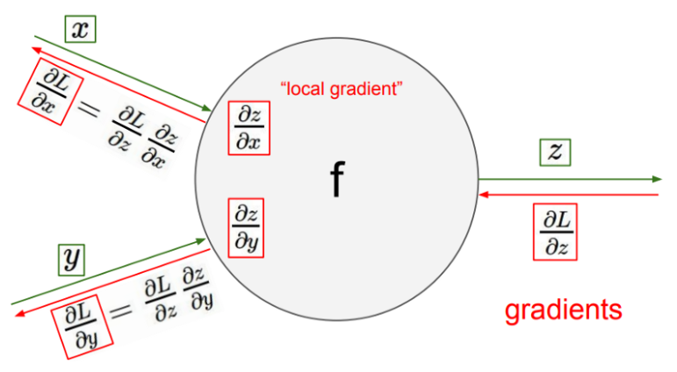
Backpropagation - NN as a Computational Graph
Neural network can be viewed as a computational graph.
  Nodes are the operations.
  Edges are the flow of data.
Backpropagation propagates gradients through graph.
Image credit : https://towardsdatascience.com/back-propagation-simplified-218430e21ad0

Slide 26
Deep Learning with NNs

Slide 27
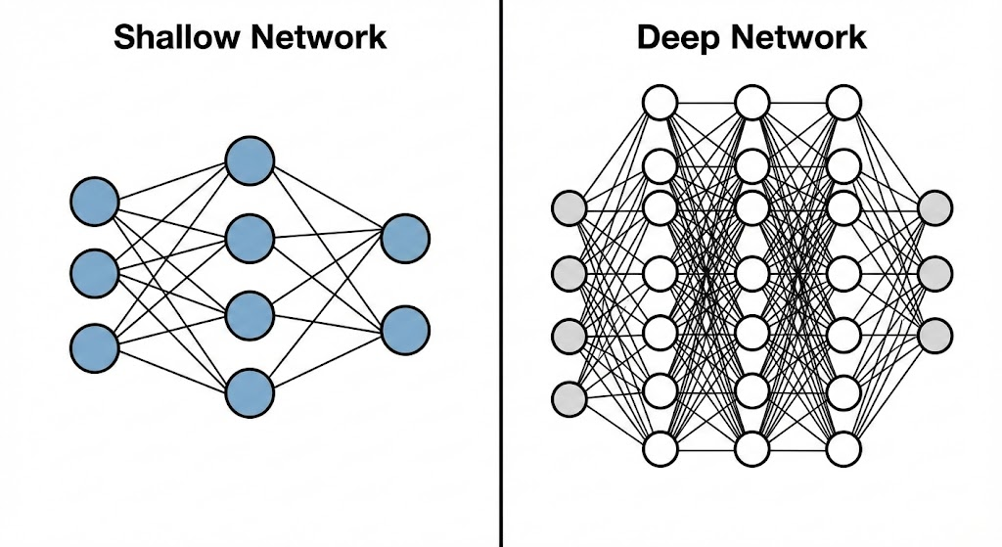
What makes it "Deep"?
Deep Learning is simply a specific class of Machine Learning based on Artificial Neural Networks with representation learning.
The Difference: The "Deep" refers strictly to the number of hidden layers in the network.
Shallow Network: 1 or 2 hidden layers.
Deep Network: Dozens, hundreds, or even thousands of layers (e.g., ResNet, GPT).
The Capacity: Adding depth allows the network to model complex, non-linear relationships that simpler models cannot capture.

Slide 28
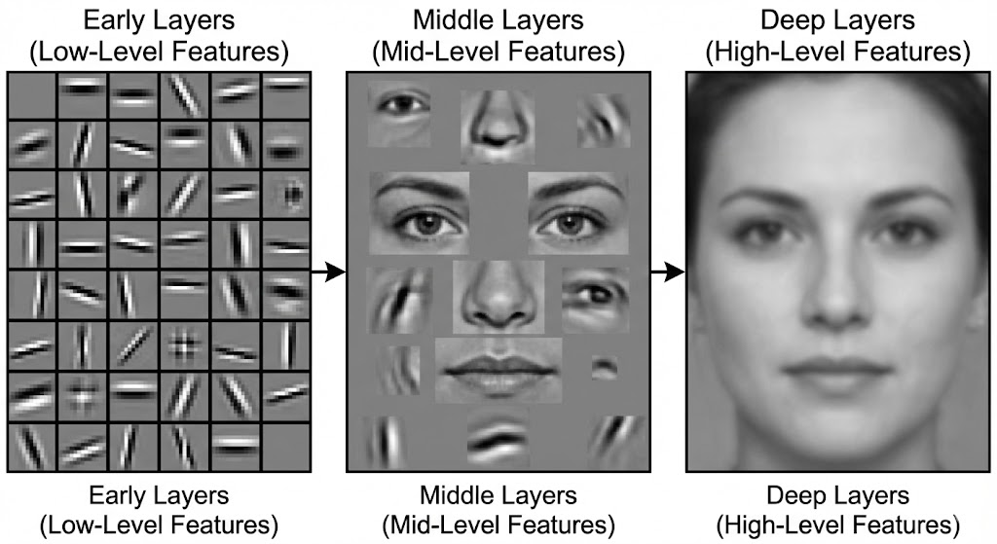
Automatic Hierarchical Feature Extraction
The Old Way: Traditional ML required humans to manually define features (e.g., "look for circular shapes" to find a car).
The Deep Learning Way: The network learns features automatically, building them up hierarchically:
Early Layers: Detect simple patterns (Edges, lines, color gradients).
Middle Layers: Combine simple patterns into complex shapes (Eyes, ears, tires, windows).
Deep Layers: Combine shapes into whole objects (Faces, cars, dogs).
End-to-End Learning: Raw data goes in -> Class/Prediction comes out. No manual feature engineering required.

Slide 29
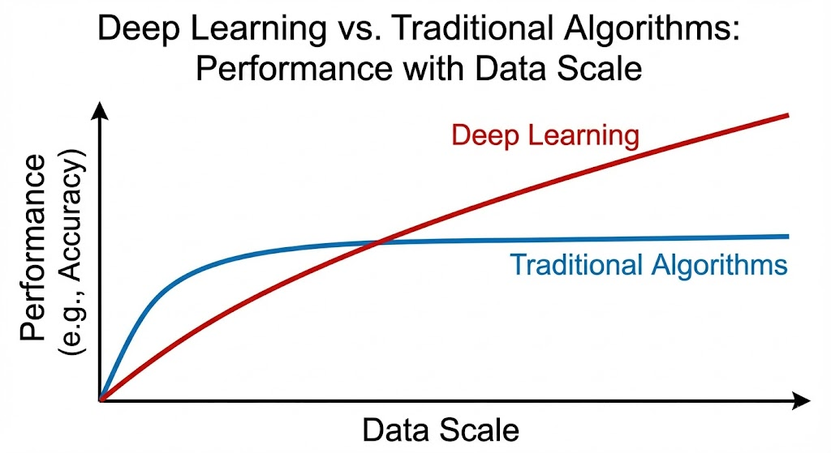
Why Deep Learning is Dominant Now
Performance vs. Data Scale:
Traditional algorithms (SVM, Logistic Regression) tend to plateau; adding more data stops improving accuracy after a certain point.
Deep Learning performance continues to improve as you feed it more data.
The "Unstructured" King: Deep Learning is unrivaled for unstructured data: Images, Video, Audio, and Text.
The Trade-offs:
Pros: State-of-the-art accuracy, automation of feature extraction.
Cons: Requires massive data, expensive hardware (GPUs), and acts as a "Black Box" (harder to interpret).

